Slide 1

Using Big Data To Solve
Economic and Social Problems
Professor Raj Chetty
Head Section Leader Rebecca Toseland
Photo Credit: Florida Atlantic University

Slide 2
Using Social Norms to Reduce Electricity Consumption: OPower Scale-Up
OPower has mailed Home Energy Reports to millions of electricity customers in markets across the U.S.
Mailings were randomly assigned, permitting experimental estimates of causal effects
Allcott and Rogers (2014) evaluate impacts of these mailings by comparing electricity usage of treated and control households

Slide 3
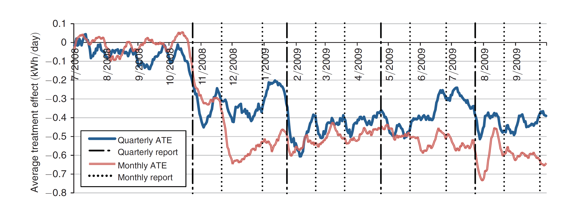
Treatment Effects of Monthly and Quarterly OPower Home Energy Reports
on Electricity Consumption
First home energy report received

Slide 4
Differential Effects of Social Norms Across Markets
OPower gradually expanded its presence to additional markets over time
Were impacts similar to those achieved in initial markets?
Allcott (2015) estimates impact of home energy reports for 111 markets separately, using data on nearly 9 million customers
In each market, construct an estimate of causal effect of home energy report by comparing treated and control households

Slide 5
Effects of OPower Home Energy Reports Across Utilities, by Program Start Date
Reduction in Electricity Usage (%)

Slide 6
Site Selection Bias in Experimental Estimates
Allcott (2015) finds that effects of OPower treatment are larger for “early adopter” utilities
  Likely because utilities with more environmentally-oriented customers signed up for the program in its early stages
Illustrates a broader methodological lesson: experimental/quasi-experimental estimates in social science are not necessarily stable across settings
Important to continue to conduct studies across areas and time periods to understand policy impacts, rather than assuming that effects will generalize

Slide 7
Summary: Policies to Mitigate Climate Change
Climate change and pollution have large social costs
  But costs are not infinite, partly because human beings can adapt
  Economic approach of quantifying environmental costs of policies and comparing them to their economic benefits is therefore very useful
Environmental damage can be mitigated through policies such as corrective taxes and changing social norms
  New data are helping us to measure what policies are necessary to achieve optimal balance of social costs and economic benefits

Slide 8
Summary: Policies to Mitigate Climate Change
Key problem going forward: addressing externalities in implementing the necessary policies at a national and global scale
  Unlike other problems we have discussed in this course, cannot be tackled at individual or local level
  Pollution emitted in California affects atmosphere in the rest of the U.S. and the world
  Policy challenge: need to develop global coalitions to tackle environmental problems

Slide 9
Outline of Remaining Lectures
Primary methodological theme of remaining lectures: applications of machine learning to prediction
Today: discrimination and criminal justice

Slide 10
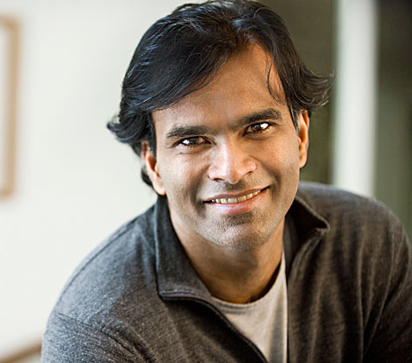
Next Tuesday: Guest Lecture by Sendhil Mullainathan
Professor of Economics, Harvard University
Co-Author of Scarcity and MacArthur “Genius”

Slide 11

Next Thursday: Guest Lecture by Matthew Gentzkow
Professor of Economics, Stanford University
Recipient of the John Bates Clark Medal

Slide 12
Outline of Remaining Lectures
Primary methodological theme of remaining lectures: applications of machine learning to prediction
Today: discrimination and criminal justice
Next Tuesday: guest lecture by Sendhil Mullainathan on using big data for prediction
Next Thursday: lecture by Matt Gentzkow on political polarization
Tuesday June 6: Concluding lecture and review of methods by Rebecca

Slide 13
Discrimination and Criminal Justice

Slide 14
Black Men’s Median Earnings vs. White Men’s Median Earnings
Among Full-Time Workers
100
90
80
Black Men’s Earnings as Percent of White Men's Earnings
70
60
50
1980
1985
1990
1995
2000
2005
2010
2015
Year
Source: Current Population Survey

Slide 15
White Women’s Median Earnings vs. White Men’s Median Earnings
Among Full-Time Workers
100
90
80
White Women’s Earnings as Percent of White Men's Earnings
70
60
50
1980
1985
1990
1995
2000
2005
2010
2015
Year
Source: Current Population Survey

Slide 16
Discrimination: Motivation
Large differences in earnings and other outcomes by race and gender in America
Partly driven by differences in economic opportunities, schools, etc. as we have discussed previously
But could also be partly driven by discrimination: differential treatment by employers and other actors based on race or gender
A series of recent studies have used experimental and quasi-experimental methods to test for discrimination

Slide 17
Racial Discrimination in Hiring
Bertrand and Mullainathan (2004) send out fictitious resumes with identical credentials in response to real job ads
Vary name of applicant to be “white-sounding” (e.g., Emily Walsh or Greg Backer) vs. “black-sounding” (e.g., Lakisha Washington or Jamal Jones)
Send 5,000 resumes in response to 1,300 help-wanted ads in newspapers in Boston and Chicago
Analyze call-back rates in response to application

Slide 18
Job Callback Rates by Race for Resumes with Otherwise Identical Credentials
12
10
8
Callback Rate (%)
6
4
All
Chicago
Boston
Female
Female
Female
Male
Admin.
Sales
Black
White
Source: Bertrand and Mullainathan (AER 2004)

Slide 19
Racial Discrimination Among Airbnb Hosts
Edelman, Luca, and Sversky (2017) use an analogous approach to study discrimination among Airbnb hosts
Send out fictitious requests to book listings in response to real postings
  Set up 20 independent accounts and sent 6400 messages to hosts from these accounts in 2015
  Randomly vary name of applicant across accounts to be white vs. black sounding (and do not include profile pictures)
Note: study was done independently using experimental accounts, not in collaboration with Airbnb

Slide 20
AirBnB Host Response Rates by Race for Individuals with Otherwise Identical Profiles
Source: Edelman, Luca, and Svirsky (AEJ 2017)

Slide 21
Racial Discrimination Among Airbnb Hosts
What happens to listings where offer was not accepted?
  Roughly 40% of these listings remained vacant on proposed date
  Rejecting black guests → loss of $65-$100 of revenue on average
Publication of Edelman, Luca, and Sversky (2017) paper pressured Airbnb to acknowledge that discrimination was prevalent on the site
Airbnb took steps to address the problem: more “Instant” bookings, reducing prominence of guest photos, increased support for discrimination complaints
But stopped short of making names and photos invisible

Slide 22
Statistical vs. Taste-Based Discrimination
Two different theories of discrimination that could in principle be consistent with these patterns:
  Taste-based discrimination: preference for employees/clients of a given race for reasons unrelated to their performance
  Statistical discrimination: use of race as a signal of other aspects of background that may matter for performance (e.g., language, inferences about effort, or skill)
Both forces harmful for qualified minorities, but distinguishing between them is important to understand the solution
  If discrimination is statistical, then providing more accurate information would help; if it is taste-based, need to change people’s preferences/attitudes

Slide 23
Statistical vs. Taste-Based Discrimination
One way to test between these two explanations is to use measures of performance/output
Do those who get screened out due to discrimination actually have lower performance?
Difficult to study directly in most settings because we don’t observe outcomes of those who don’t get the job or the Airbnb booking

Slide 24
Sex-Based Discrimination in Orchestra Auditions
One setting where people can see productivity: auditions for orchestras
Goldin and Rouse (2000) compare outcomes of auditions that were “blind” (behind a curtain) vs. non-blind
  Data from eight major symphony orchestras from 1950-1995
  14,000 auditions, some of which were blind and some of which were not, depending upon orchestra policy

Slide 25
Average Success Rates at Orchestra Auditions by Sex and Type of Audition
30
25
20
15
Proportion Who Advance to Next Round (%)
10
5
0
Blind Audition
Non-blind Audition
Women
Men
Source: Goldin and Rouse (AER 2000)

Slide 26
Sex-Based Discrimination in Orchestra Auditions
Goldin and Rouse results suggest that discrimination is partly taste-based (or based on biased beliefs about performance)
If all one cares about is quality of music performance, then orchestras are sacrificing performance quality by giving men a preference

Slide 27
Biases due to Decision Fatigue
Discrimination/suboptimal choice is not driven entirely by deep-rooted beliefs
Decisions also vary greatly based on factors unrelated to substantive features of the issue at hand
Danziger et al. (2011) demonstrate this by analyzing data on judges’ decisions to grant prisoners parole

Slide 28
Studying Decision Fatigue in Parole Decisions
Data: 1,100 judicial rulings on parole for prisoners in Israel over 10 months
Judges review about 20 cases on average each day in succession
  Ordering of cases depends upon when attorney shows up and is essentially random
Judges can decide to grant parole or reject (delay to a future hearing, maintaining status quo)
Key institutional feature: two breaks during the day for meals
  10 am for late-morning snack (40 mins)
  1 pm for lunch (1 hour)

Slide 29
Proportion of Rulings in Favor of Prisoner by Time of Interview During the Day
Break
For
Lunch
Break
for
Snack
Source: Danziger, Levav, Avnaim-Pesso (PNAS 2011)

Slide 30
Can Machines Help Humans Overcome Biases?
Most recent literature asks whether big data and machine learning can help people make decisions that are less biased
Idea: develop algorithms to predict outcomes of interest and use these to guide or replace human decisions
Analogous to the way in which Netflix presents movie recommendations based on history of movies viewed, demographics, etc.
These algorithms are not necessarily subject to human biases, but do they outperform humans’ decisions overall or have other biases/shortcomings?

Slide 31
Decisions to Jail vs. Release Defendants
Kleinberg et al. (2017) compare the accuracy of human decisions and machine predictions in the criminal justice system
Every year, ~10 million people are arrested in the U.S.
After arrest, judges decide whether to hold defendants in jail or let them go
By law, decision is made with the objective of minimizing risk of flight (failure to appear at trial)
Kleinberg et al. compare machine learning predictions and judges’ actual decisions in terms of performance in achieving this objective

Slide 32
Decisions to Jail vs. Release Defendants
Data: 750,000 individuals arrested in New York City between 2008-2013
  Same data on prior history that is available to judge (rap sheet, current offense, etc.)
  Data on subsequent crimes to develop and evaluate performance of algorithm
Define “crime” as failing to show up at trial; objective is to jail those with highest risk of committing this crime
  Other definitions of crime (e.g., repeat offenses) yield similar results
First divide data into three separate samples

Slide 33
Data Used for Empirical Analysis
Source: Kleinberg et al. (2017)

Slide 34
Methodology: Machine Learning Using Decision Trees
Predict probability of committing a crime using a machine learning method called decision trees
Main statistical challenge: need to avoid overfitting the data with large number of potential predictors
  Can get very good in-sample fit but have poor performance out-of-sample (analogous to issues with Google flu trend)
  Solve this problem using cross-validation, using separate samples for estimation and evaluation of predictions

Slide 35
Methodology: Machine Learning Using Decision Trees
Three steps to develop predictions using decision trees
Split the data based on the variable that is most predictive of differences in crime rates

Slide 36

Hypothetical Decision Tree for Decision to Jail Defendant
$$Arrest Charge$$
Felony
Misdemeanor

Slide 37
Methodology: Machine Learning Using Decision Trees
Three steps to develop predictions using decision trees
Split the data based on the variable that is most predictive of differences in crime rates
Grow the tree up to a given number of nodes N

Slide 38



Hypothetical Decision Tree for Decision to Jail Defendant
$$Arrest Charge$$
Felony
Misdemeanor
$$Age$$
Below 30
Above 30
$$Yes$$
$$No$$

Slide 39



Hypothetical Decision Tree for Decision to Jail Defendant
$$Arrest Charge$$
Felony
Misdemeanor
$$Age$$
$$Prior Crime$$
Below 30
Above 30
No
Yes
$$Yes$$
$$No$$
$$No$$
$$Yes$$

Slide 40
Methodology: Machine Learning Using Decision Trees
Three steps to develop predictions using decision trees
Split the data based on the variable that is most predictive of differences in crime rates
Grow the tree up to a given number of nodes N
Use separate validation sample to evaluate accuracy of predictions based on a tree of size N
Repeat steps 1-3 varying N and choose tree-size N that minimizes average prediction errors

Slide 41
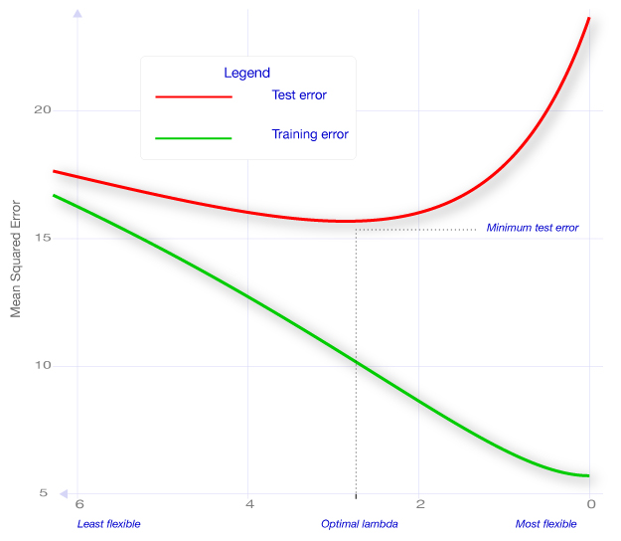

Prediction Errors vs. Size of Decision Tree
2.0
Average Prediction Error
Prediction error in validation (test) sample
1.5
1.0
Pick number of nodes to minimize prediction errors in validation sample
Prediction error in estimation sample
Optimal N
0.5
0
0
$$λ$$
20
40
60
Number of Nodes N

Slide 42
Comparing Machine Predictions to Human Predictions
Applying this method yields predictions of crime rates for each defendant
Machine-based decision rule: jail the defendants who have the highest predicted risk
How does this machine-based rule compare to what judges actually do in terms of crime rates it produces?
Answer is not obvious: judges can see things that are not in the case file, such as defendant’s demeanor in courtroom

Slide 43
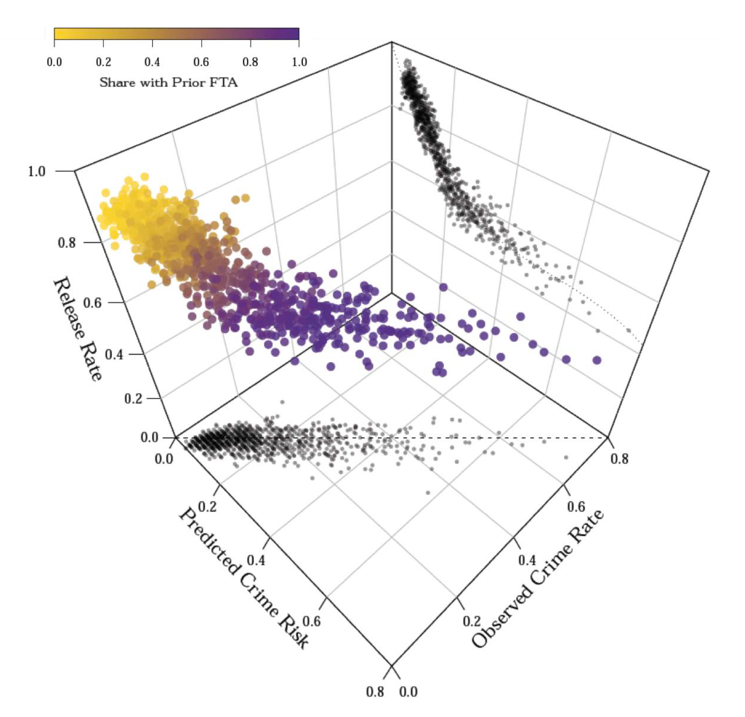
Judges’ Release Decisions vs. Machine Predictions and Crime Risk

Slide 44
Judges’ Release Decisions vs. Machine Predictions and Crime Risk
Predicted crime risk is highly correlated with observed crime rates (for defendants who are released)

Slide 45
Judges’ Release Decisions vs. Machine Predictions and Crime Risk
Judges release 50% of defendants whose predicted crime risk
exceeds 60%

Slide 46
Judges’ Release Decisions vs. Machine Predictions and Crime Risk
Judges release 50% of defendants whose predicted crime risk
exceeds 60%
Yet they jail 30% of defendants with crime risks of only 20%

Slide 47
Judges’ Release Decisions vs. Machine Predictions and Crime Risk
Judges release 50% of defendants whose predicted crime risk
exceeds 60%
Yet they jail 30% of defendants with crime risks of only 20%
Swapping low-risk and high-risk defendants would keep jail population fixed while lowering crime rates

Slide 48
Comparing Machine Predictions to Human Predictions
How large are the gains from machine prediction?
  Crime could be reduced by 25% with no change in jailing rates
  Or jail populations could be reduced by 42% with no change in crime rates
Why? One explanation: Judges may be affected by cues in the courtroom (e.g., defendant’s demeanor) that do not predict crime rates
Whatever the reason, gains from machine-based “big data” predictions are substantial in this application

Slide 49
Predictive Policing
Another active area of research and application of big data in criminology: predictive policing
  Predict (and prevent) crime before it happens
Two approaches: spatial and individual
  Spatial methods rely on clustering of criminal activity by area and time

Slide 50
Times Between Burglary Events Separated by 0.1 Miles or Less
# Event Pairs
Time (Days)
Source: Mohler et al. (JASA 2011)

Slide 51
Predictive Policing
Another active area of research and application of big data in criminology: predictive policing
  Predict (and prevent) crime before it happens
Two approaches: spatial and individual
  Spatial methods rely on clustering of criminal activity by area and time
  Individual methods rely on individual characteristics, social networks, or data on behaviors (“profiling”)

Slide 52
Ethical Debate Regarding Predictive Analytics
Use of big data for predictive analytics raises serious ethical concerns, particularly in the context of criminal justice
Tension between two views:
  Should a person be treated differently simply because they share attributes with others who have higher risks of crime?
  Should police/judges/decision makers discard information that could help make society fairer and potentially more just than it is now on average?
Further research on costs and benefits of predictive analytics and study of ethical issues required before widespread application

Slide 53
Using Big Data to Solve Economic and Social Problems
What we’ve learned in teaching this class
  What we see in the data are reflected in your stories
  Teaching the tools of social science through applications is valuable
  Couldn’t have done it without Rebecca, Christos, Evan, Jason, Juan, and Will
What do we want you to take from this course?
  Methods to analyze real-world problems
  The value of taking a data-based, scientific approach to policy questions
  An interest in focusing on the social good

Slide 54

An Opportunity and a Challenge
Area | Chance of Rising from Bottom to Top Fifth
Dubuque, IA | 17.9%
San Jose, CA | 12.9%
Washington DC | 10.5%
Chicago, IL | 6.5%
Memphis, TN | 2.6%

